Slide 1

Data Integration and Large Scale Analysis 06 Data Cleaning
Slides Credit: Matthias Boehm
Last update: Nov 22, 2024

Slide 2
Agenda
Motivation and Terminology
Data Cleaning and Fusion
Missing Value Imputation

Slide 3
Motivation and Terminology

Slide 4
Recap: Corrupted/Inconsistent Data
Motivation and Terminology
#1 Heterogeneity of Data Sources
Update anomalies on denormalized data / eventual consistency
Changes of app/prep over time (US vs us) → inconsistencies
#2 Human Error
Errors in semi-manual data collection, laziness (see default values), bias
Errors in data labeling (especially if large-scale: crowd workers / users)
#3 Measurement/Processing Errors
Unreliable HW/SW and measurement equipment (e.g., batteries)
Harsh environments (temperature, movement) → aging
Uniqueness & duplicates
Contradictions & wrong values
Missing Values
[Credit: Felix Naumann]
Ref. Integrity
ID | Name | BDay | Age | Sex | Phone | Zip
3 | Smith, Jane | 05/06/1975 | 44 | F | 999-9999 | 98120
3 | John Smith | 38/12/1963 | 55 | M | 867-4511 | 11111
7 | Jane Smith | 05/06/1975 | 24 | F | 567-3211 | 98120
Zip | City
98120 | San Jose
90001 | Lost Angeles
Typos

Slide 5
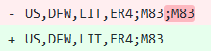
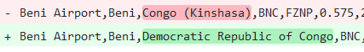
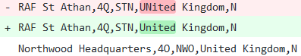
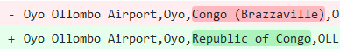
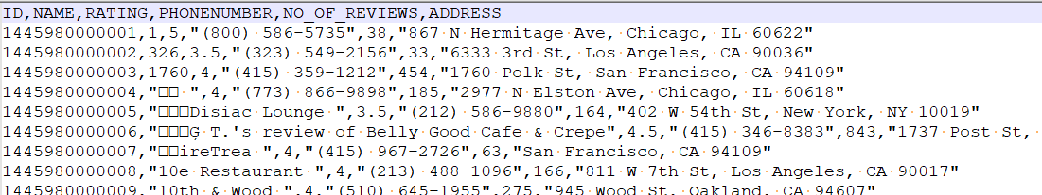
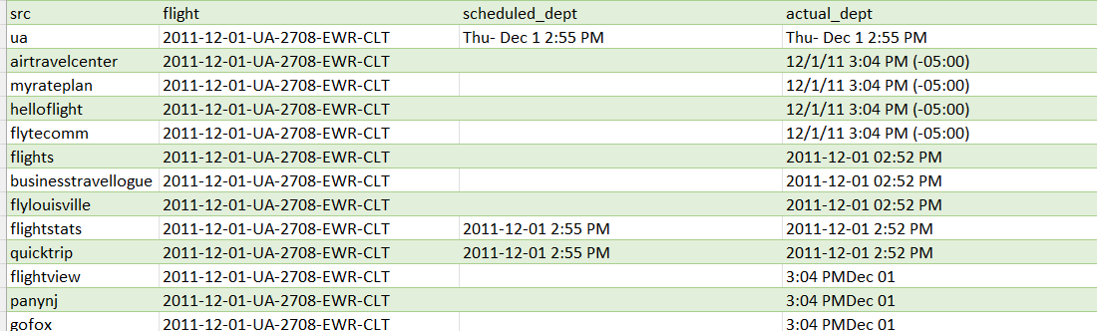
Examples (aka errors are everywhere)
Motivation and Terminology
Duplicates
Formatting
Data Entry Errors
Encoding errors
Missing values
Date-time encoding

Slide 6
Terminology
Motivation and Terminology
#1 Data Cleaning (aka Data Cleansing)
Detection and repair of data errors
Outliers/anomalies: values or objects that do not match normal behavior (different goals: data cleaning vs finding interesting patterns)
Data Fusion: resolution of inconsistencies and errors (e.g., entity resolution see Lecture 05)
#2 Missing Value Imputation
Fill missing info with “best guess”
Difference between NAs and 0 (or special values like NaN) for ML models
#3 Data Wrangling
Automatic cleaning unrealistic? → Interactive data transformations
Recommended transforms + user selection
Note: Partial Overlap w/ KDDM ➔ it’s fine, different perspectives

Slide 7
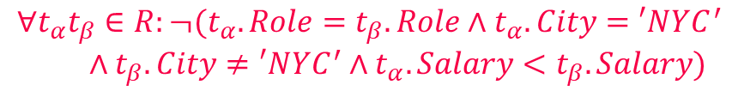
Express Expectations as Validity Constraints
Motivation and Terminology
Manual Approach: “Common Sense”
(Semi-)Automatic Approach: Expectations!
PK → Values must be unique and defined (not null)
Exact PK-FK → Inclusion dependencies
Noisy PK-FK → Robust inclusion dependencies |R[X]∈S[Y]| / |R[X]| > δ
Semantics of attributes → Value ranges / # distinct values
Invariant to capitalization → Duplicates that differ in capitalization
Patterns → regular expressions
Formal Constraints
Functional dependencies (FD), conditional FDs (CFD), metric dependencies
Inclusion dependencies, matching dependencies
Denial constraints
Route (Airline, From, To)
Planes
Age=9999?
2019-11-15 vs Nov 15, 2019
$$∀t_{α}t_{β}∈R:¬(t_{α}.Role=t_{β}.Role∧t_{α}.City=′NYC^{′}$$ $∧t_{β}.City≠′NYC^{′}∧t_{α}.Salary<t_{β}.Salary)$

Slide 8
Data Cleaning and Fusion

Slide 9
Data Validation
Data Cleaning and Fusion
validation checks on expected shape before training first model
Check a feature’s min, max, and most common value
Ex: Latitude values must be within the range [-90, 90] or [-π/2, π/2]
The histograms of continuous or categorical values are as expected
Ex: There are similar numbers of positive and negative labels
Whether a feature is present in enough examples
Ex: Country code must be in at least 70% of the examples
Whether a feature has the right number of values (i.e., cardinality)
Ex: There cannot be more than one age of a person
[Neoklis Polyzotis, Sudip Roy, Steven Euijong Whang, Martin Zinkevich: Data Management Challenges in Production Machine Learning. Tutorial, SIGMOD 2017]
(Google Research)

Slide 10
Data Validation, cont.
Data Cleaning and Fusion
[Sebastian Schelter, Dustin Lange, Philipp Schmidt, Meltem Celikel, Felix Bießmann, Andreas Grafberger: Automating Large-Scale Data Quality Verification. PVLDB 2018]
Constraints and Metrics for quality check UDFs
Approach
#1 Quality checks on basic metrics, computed in Apache Spark
#2 Incremental maintenance of metrics and quality checks
(Amazon Research)
Organizational Lesson: benefit of shared vocabulary/procedures
Technical Lesson: fast/scalable; reduce manual and ad-hoc analysis
Notes:
Data to Models and Back DEEM workshop see if u can extend TFDV

Slide 11
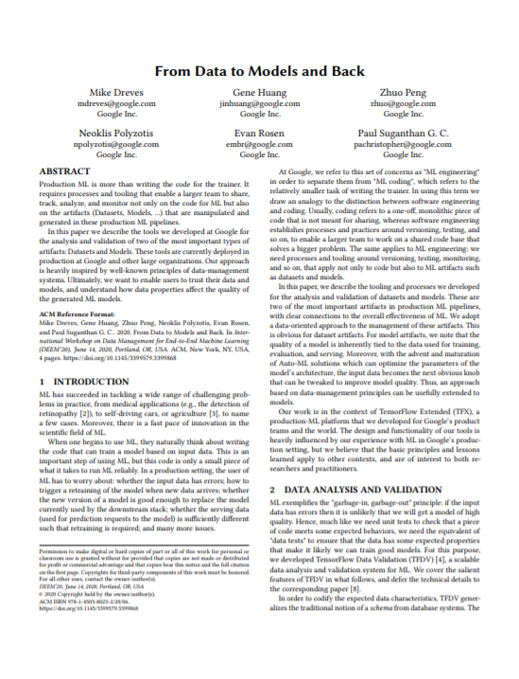
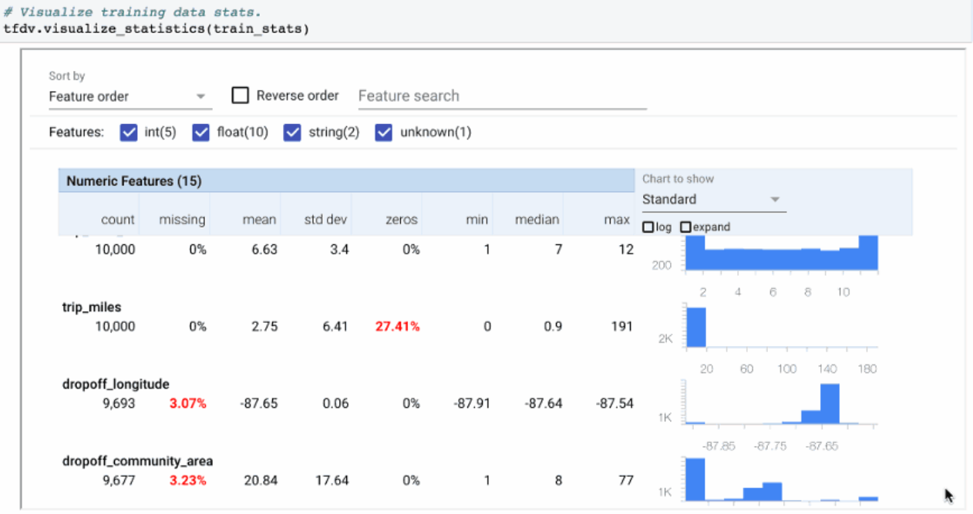
Data Validation, cont.
Data Cleaning and Fusion
[Mike Dreves; Gene Huang; Zhuo Peng; Neoklis Polyzotis; Evan Rosen; Paul Suganthan: From Data to Models and Back. DEEM 2020]
TensorFlow Data Validation (TFDV)
Library or TFX components
Provides functions for stats computation, validation checks and anomaly detection
(Google)

Slide 12
Standardization and Normalization
Data Cleaning and Fusion
#1 Standardization
Centering and scaling to mean 0 and variance 1
Ensures well-behaved training
Densifying operation
Awareness of NaNs
Batch normalization in DNN: standardization of activations
#2 Normalization
Aka min-max normalization
Rescale values into common range [0,1]
Avoid bias to large-scale features
Does not handle outliers
X = X – colMeans(X);
X = X / sqrt(colVars(X));
X = replace(X, pattern=NaN, replacement=0); #robustness
X = (X – colMins(X))
/ (colMaxs(X) – colMins(X));

Slide 13
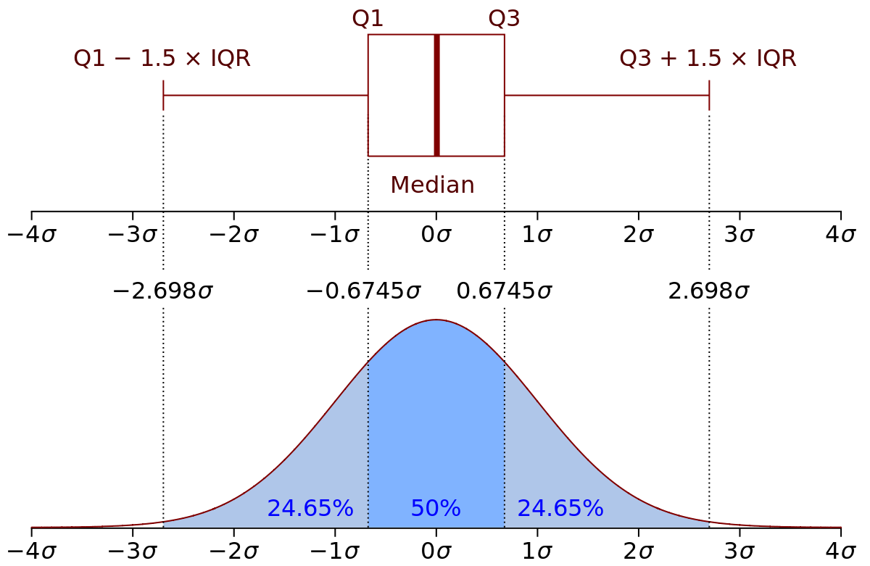
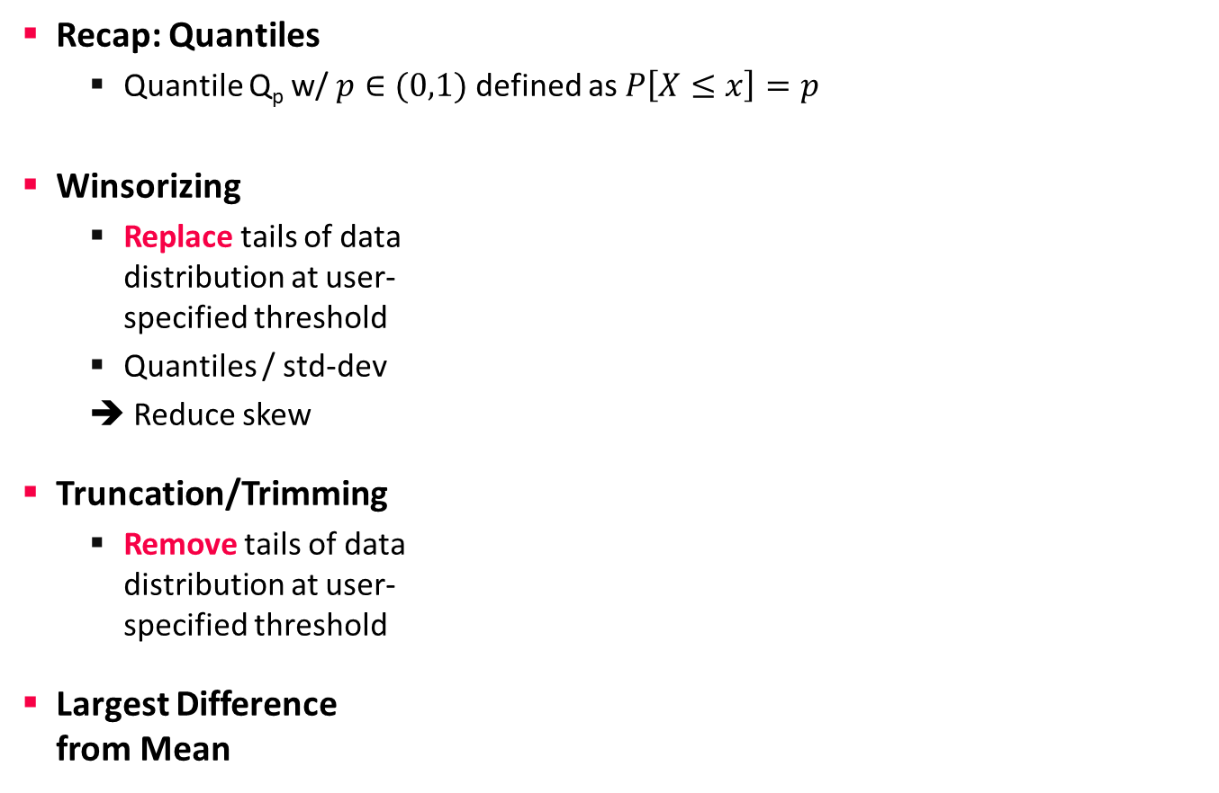
Winsorizing and Trimming
Data Cleaning and Fusion
Recap: Quantiles
Quantile Q_{p} w/ $p∈(0,1)$ defined as $P\left[X≤x\right]=p$
Winsorizing
Replace tails of data distribution at user- specified threshold
Quantiles / std-dev
➔ Reduce skew
Truncation/Trimming
Remove tails of data distribution at user- specified threshold
Largest Difference from Mean
[Credit: https://en.wikipedia.org]
# compute quantiles for lower and upper
ql = quantile(X, 0.05);
qu = quantile(X, 0.95);
# replace values outside [ql,qu] w/ ql and qu
Y = ifelse(X < ql, ql, X);
Y = ifelse(Y > qu, qu, Y);
SystemDS: winsorize() outlier()
# remove values outside [ql,qu]
I = X < qu | X > ql;
Y = removeEmpty(X, “rows”, select = I);
# determine largest diff from mean
I = (colMaxs(X)-colMeans(X)) > (colMeans(X)-colMins(X));
Y = ifelse(xor(I,op), colMaxs(X), colMins(X));
Notes:
Box and whisker plots
SystemDS: quantiles via sort+pick, quickselect possible
Iterative winsoring/trimming to X std-devs of mean also possible

Slide 14
Winsorizing and Trimming, cont.
Data Cleaning and Fusion
SystemDS outlierByIQR
less than Q1 – ( k×IQR ) or greater than Q3 + ( k×IQR ) → outlier
SystemDS outlierBySd
less than mean – ( k×stdev ) or greater than mean + ( k×stdev ) → outlier
Methods for Handling Outliers
Replace outliers with default values (constants or mean/median/mode)
Update outliers as missing values
Data clipping
Q1
median
Q3
Q1 – 1.5 * IQR
IQR
Q3 + 1.5 * IQR
Outlier
-3σ
-2σ
-1σ
µ
1σ
2σ
3σ
Notes:
Box and whisker plots
SystemDS: quantiles via sort+pick, quickselect possible
Iterative winsoring/trimming to X std-devs of mean also possible

Slide 15
Outliers and Outlier Detection
Data Cleaning and Fusion
Types of Outliers
Point outliers: single data points far from the data distribution
Contextual outliers: noise or other systematic anomalies in data
Sequence (contextual) outliers: sequence of values w/ abnormal shape/agg
Univariate vs multivariate analysis
Beware of underlying assumptions (distributions)
Types of Outlier Detection
Type 1 Unsupervised: No prior knowledge of data, similar to unsupervised clustering → expectations: distance, # errors
Type 2 Supervised: Labeled normal and abnormal data, similar to supervised classification
Type 3 Normal Model: Represent normal behavior, similar to pattern recognition → expectations: rules/constraints
[Varun Chandola, Arindam Banerjee, Vipin Kumar: Anomaly detection: A survey. ACM Comput. Surv. 2009]
[Victoria J. Hodge, Jim Austin: A Survey of Outlier Detection Methodologies. Artif. Intell. Rev. 2004]

Slide 16
Outlier Detection Techniques
Data Cleaning and Fusion
Classification
Learn a classifier using labeled data
Binary: normal / abnormal
Multi-class: k normal / abnormal (one against the rest) → none=abnormal
Examples: AutoEncoders, Bayesian Networks, SVM, decision trees
K-Nearest Neighbors
Anomaly score: distance to kth nearest neighbor
Compare distance to threshold + (optional) max number of outliers
Clustering
Clustering of data points, anomalies are points not assigned / too far away
Examples: DBSCAN (density), K-means (partitioning)
Cluster-based local outlier factor (global, local, and size-specific density)
[Varun Chandola, Arindam Banerjee, Vipin Kumar: Anomaly detection: A survey. ACM Comput. Surv. 2009]
Notes:
Coverage analysis search coverage in slicing paper
XGBoost

Slide 17
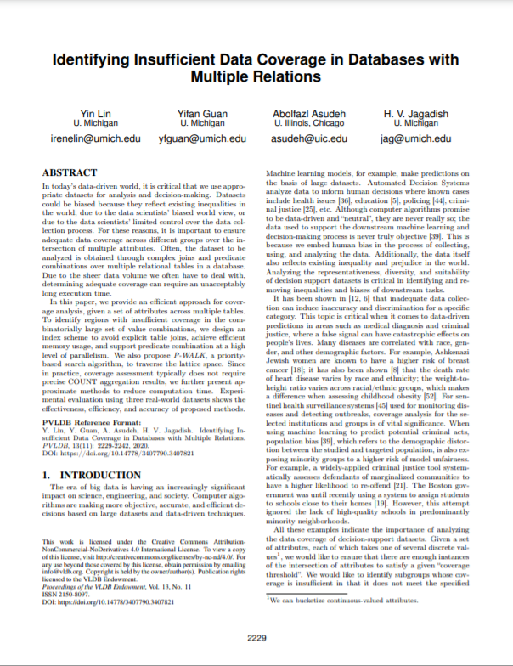
Outlier Detection Techniques, cont.
Data Cleaning and Fusion
Frequent Itemset Mining
Rare itemset mining / sequence mining; Examples: Apriori/Eclat/FP-Growth
Coverage Analysis
Given a database D and a data pattern P
Coverage of a data pattern cov(P) is defined as the number of records in table T that satisfy pattern P
Pattern P is a covered pattern if cov(P) ≥ τ
Otherwise, this pattern is said to be uncovered
TID | Items
1 | Bread, Milk
2 | Bread, Diaper, Beer, Eggs
3 | Milk, Diaper, Beer, Coke
4 | Bread, Milk, Diaper, Beer
5 | Bread, Milk, Diaper, Coke
[Yin Lin et al: Identifying Insufficient Data Coverage in Databases with multiple Relations. PVLDB 2020]
Notes:
Coverage analysis search coverage in slicing paper
XGBoost

Slide 18
Time Series Anomaly Detection
Data Cleaning and Fusion
Basic Problem Formulation
Given regular (equi-distant) time series of measurements
Detect anomalous subsequences s of length l (fixed/variable)
Anomaly Detection
#1 Supervised: Classification problem
#2 Unsupervised: k-Nearest Neighbors (discords) → All-pairs similarity join
[Matrix Profile XXVIII, SDM 2023]
[Chin-Chia Michael Yeh et al: Matrix Profile I: All Pairs Similarity Joins for Time Series: A Unifying View That Includes Motifs, Discords and Shapelets. ICDM 2016]

Slide 19
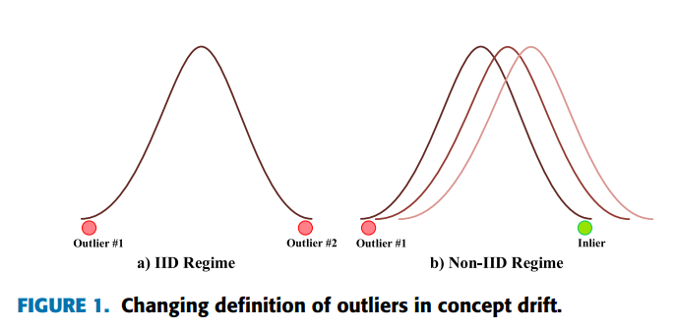
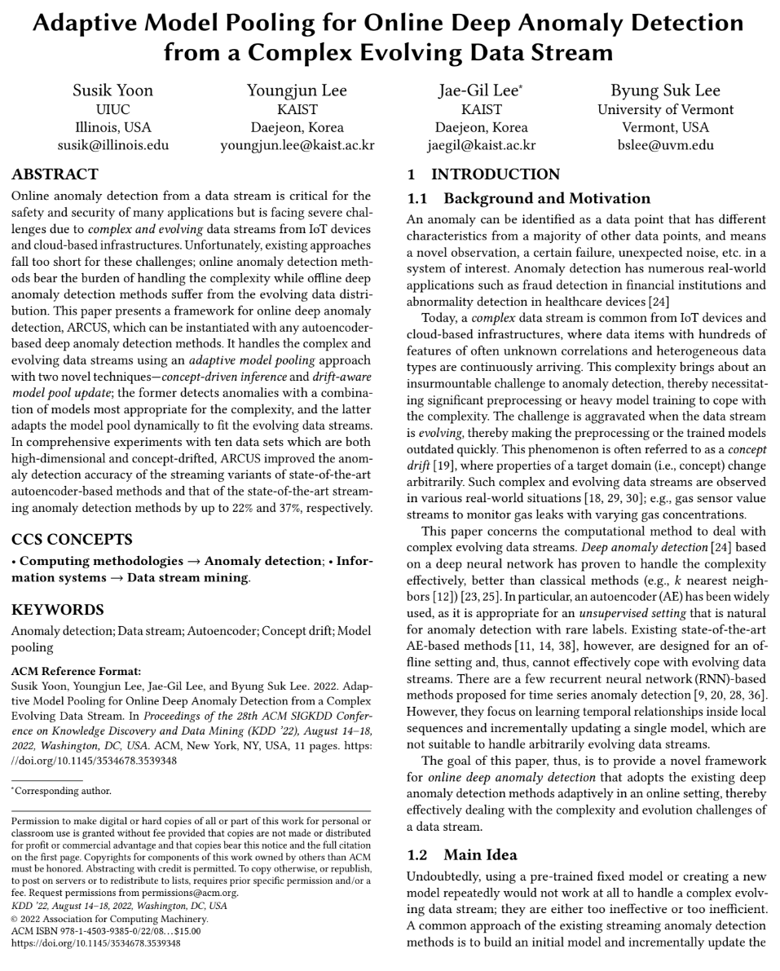
Outlier Detection in Non-IID Data
Data Cleaning and Fusion
Non-Independent and Identically Distributed (non-IID)
Inter-dependencies, correlations, heterogeneity, and non-stationarity
Indicating coupling, correlations between variables
ARCUS (Adaptive framework foR online deep anomaly deteCtion Under a complex evolving data Stream)
A model pool of auto-encoders
Same structure but different hyperparameters
Concept drift aware pool adaption using Hoeffding’s Inequality (statistical test)
[Susik Yoon et. al. Adaptive Model Pooling for Online Deep Anomaly Detection from a Complex Evolving Data Stream. KDD 2022]
https://datasciences.org/non-iid-learning/

Slide 20
Automatic Data Repairs
Data Cleaning and Fusion
Overview Repairs
Question: Repair data, rules/constraints, or both?
General principle: “minimality of repairs”
Example Data Repair
Functional dependency A→ B
Violation for A=1
Note: Piece-meal vs holistic data repairs
[Xu Chu, Ihab F. Ilyas: Qualitative Data Cleaning. Tutorial, PVLDB 2016]
OK, dist=1
A | B
1 | 2
1 | 3
1 | 3
4 | 5
A | B
1 | 3
1 | 3
1 | 3
4 | 5
A | B
1 | 2
1 | 2
1 | 2
4 | 5
A | B
1 | 5
1 | 5
1 | 5
4 | 5
vs
vs

Slide 21
Automatic Data/Rule Repairs, cont.
Data Cleaning and Fusion
Example
Expectation: City → Country; new data conflicts
Relative Trust: {FName, LName} → Salary
Trusted FD: ➔ change salary according to {FName, LName} → Salary
Trusted Data: ➔ change FD to {FName, LName, DoB, Phone} → Salary
Equally-trusted: ➔ change FD to {FName, LName, DoB} → Salary AND data accordingly
[George Beskales, Ihab F. Ilyas, Lukasz Golab, Artur Galiullin: On the relative trust between inconsistent data and inaccurate constraints. ICDE 2013]
IATA | ICAO | Name | City | Country
MEL | YMML | Melbourne International Airport | Melbourne | Australia
MLB | KMLB | Melbourne International Airport | Melbourne | USA
x
x
x
x
x
x
Max d changes
dist_{D}
x
x
x
x
dist_{C}

Slide 22
Excursus: Simpson’s Paradox
Data Cleaning and Fusion
Overview: Statistical paradox stating that an analysis of groups may yield different results at different aggregation levels
Example UC Berkeley ‘73
 | Men |  | Women
 | Appl. | Adm. | Appl. | Adm.
A | 825 | 62% | 108 | 82%
B | 560 | 63% | 25 | 68%
C | 325 | 37% | 593 | 34%
D | 417 | 33% | 375 | 35%
E | 191 | 28% | 393 | 24%
F | 373 | 6% | 341 | 7%
 | Applicants | Admitted
Men | 8442 | 44%
Women | 4321 | 35%
➔ more women had applied to departments that admitted a small percentage of applicants
“The real Berkeley story A Wall Street Journal interview with Peter Bickel, one of the statisticians involved in the original study, makes clear that Berkeley was never sued—it was merely afraid of being sued”
[https://www.refsmmat.com/ posts/2016-05-08-simpsons -paradox-berkeley.html]

Slide 23
Selected Research
Data Cleaning and Fusion
[Jiannan Wang et al: A sample-and-clean framework for fast and accurate query processing on dirty data. SIGMOD 2014]
ActiveClean (SampleClean)
Suggest sample of data for manual cleaning (rule/ML-based detectors, Simpson's paradox)
Example Linear Regression
Approach: Cleaning and training as form of SGD
Initialization: model on dirty data
Suggest sample of data for cleaning
Compute gradients over newly cleaned data
Incrementally update model w/ weighted gradients of previous steps
[Sanjay Krishnan et al: ActiveClean: Interactive Data Cleaning For Statistical Modeling. PVLDB 2016]

Slide 24
Selected Research, cont.
Data Cleaning and Fusion
HoloClean
Clean and enrich based on quality rules, value correlations, and reference data
Probabilistic models for capturing data generation
HoloDetect
Learn data representations of errors
Data augmentation w/ erroneous data from sample of clean data (add/remove/exchange characters)
Other Systems
AlphaClean (generate data cleaning pipelines) [preprint 2019]
BoostClean (generate repairs for domain value violations) [preprint 2017]
CPClean (prioritize repairs on incomplete data)[Bojan Karlaš et al. PVLDB 2021]
[Theodoros Rekatsinas, Xu Chu, Ihab F. Ilyas, Christopher Ré: HoloClean: Holistic Data Repairs with Probabilistic Inference. PVLDB 2017]
[Alireza Heidari, Joshua McGrath, Ihab F. Ilyas, Theodoros Rekatsinas: HoloDetect: Few-Shot Learning for Error Detection, SIGMOD 2019]

Slide 25
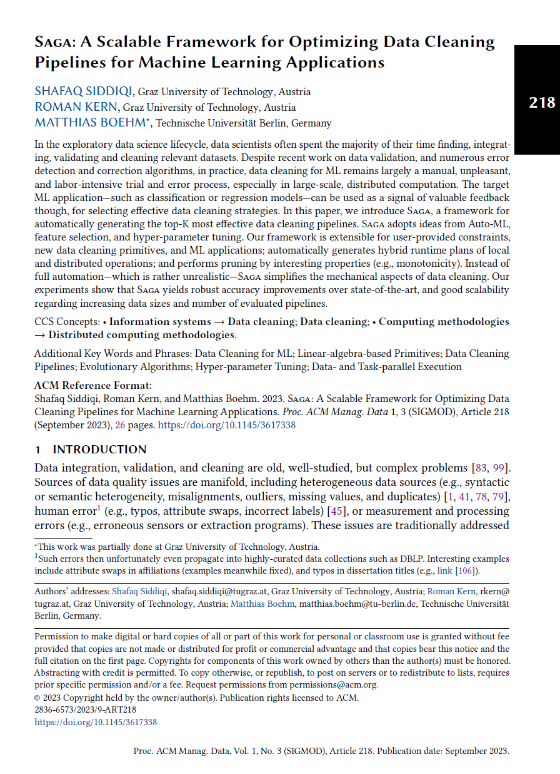
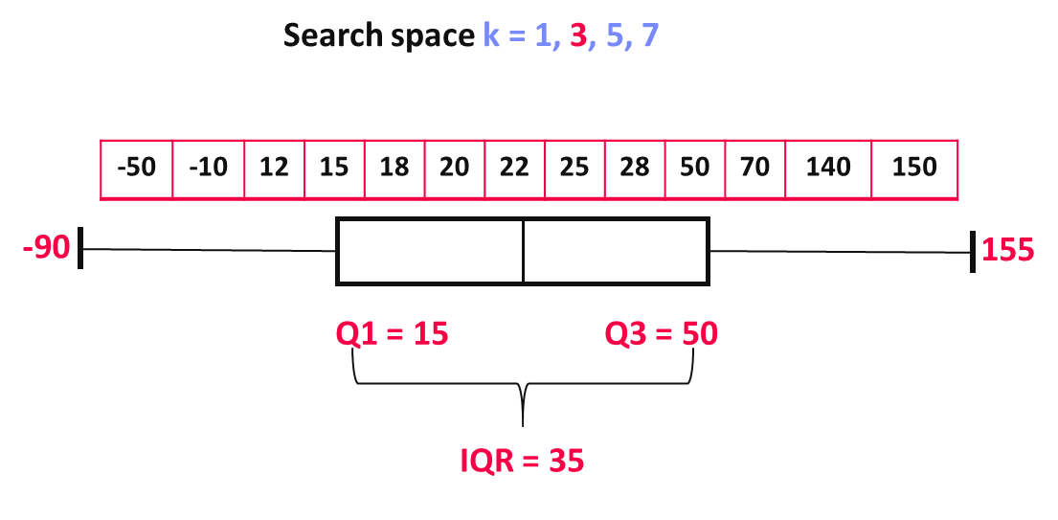
Selected Research, cont.
Data Cleaning and Fusion
[Shafaq Siddiqi, Roman Kern, Matthias Boehm: SAGA: A Scalable Framework for Optimizing Data Cleaning Pipelines for Machine Leaning Applications. SIGMOD 2024]
SAGA
Generate and optimize data cleaning pipelines
Find the best sequence of cleaning primitives (logical pipelines)
Optimize the hyper-parameters of logical pipelines (physical pipelines)
Pruning By Monotonicity
outlierByIQR(X, k)
Search space k = 1, 3, 5, 7
1
Prune Search space k > 3
-50 | -10 | 12 | 15 | 18 | 20 | 22 | 25 | 28 | 50 | 70 | 140 | 150
-20
80
Q1 = 15
Q3 = 50
IQR = 35

Slide 26
Query Planning w/ Data Cleaning
Data Cleaning and Fusion
Problem
Given query tree or data flow graph
Find placement of data cleaning operators to reduce costs
Approach
Budget B of user actions
Active learning user feedback on query results
Map query results back to sources via lineage
Cleaning in decreasing order of impact
Extensions?
Query-aware placement/refinement (e.g., UK) of cleaning primitives
Ordering of cleaning primitives (norm, dedup, missing value?)
[Dong Deng et al: The Data Civilizer System. CIDR 2017]
⨝
σ_{UK}
S
dedup
R

Slide 27


Data Wrangling
Data Cleaning and Fusion
[Vijayshankar Raman, Joseph M. Hellerstein: Potter's Wheel: An Interactive Data Cleaning System. VLDB 2001]
Data Wrangler Overview
Interactive data cleaning via spreadsheet-like interfaces
Iterative structure inference, recommendations, and data transformations
Predictive interaction (infer next steps from interaction)
Commercial/Free Tools
Trifacta (from Data Wrangler)
Google Fusion Tables: semi-automatic resolution and deduplication (sunset Dec 2019)
[Sean Kandel, Andreas Paepcke, Joseph M. Hellerstein, Jeffrey Heer: Wrangler: interactive visual specification of data transformation scripts. CHI 2011]
[Jeffrey Heer, Joseph M. Hellerstein, Sean Kandel: Predictive Interaction for Data Transformation. CIDR 2015]

Slide 28
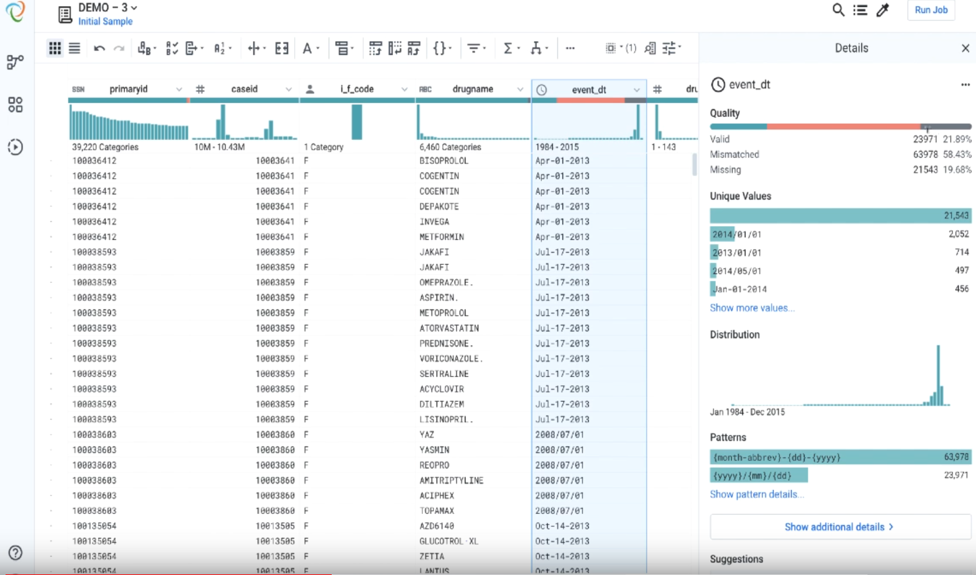
Data Wrangling, cont.
Data Cleaning and Fusion
[Credit: Alex Chan (Apr 2, 2019) https://www.trifacta.com/blog/trifacta-for-data-quality-introducing-smart-cleaning/]
Example: Trifacta Smart Cleaning

Slide 29
Missing Value Imputation

Slide 30
Basic Missing Value Imputation
Missing Value Imputation
Missing Value
Application context defines if 0 is missing value or not
If differences between 0 and missing values, use NA or NaN?
Could be a number outside the domain or symbol as ‘?’
Relationship to Data Cleaning
Missing value is error, need to generate data repair
Data imputation techniques can be used as outlier/anomaly detectors
Recap: Reasons
#1 Heterogeneity of Data Sources
#2 Human Error
#3 Measurement/Processing Errors
MCAR: Missing Completely at Random
MAR: Missing at Random
MNAR: Missing Not at Random

Slide 31
Basic Missing Value Imputation
Missing Value Imputation
ID | Position | Salary ($)
1 | Manager | null
2 | Secretary | 2200
3 | Manager | 3600
4 | Technician | null
5 | Technician | 2500
6 | Secretary | null
Missing Completely at Random
Missing values are randomly distributed across all records (independent from recorded or missing values)
Missing at Random
Missing values are randomly distributed within one or more sub-groups of records
Missing values depend on the recorded but not on the missing values, and can be recovered
Not Missing at Random
Missing data depends on the missing values themselves
E.g., missing low salary, age, weight, etc.
(3500)
(2400)
(2000)
ID | Position | Salary ($)
1 | Manager | 3500
2 | Secretary | 2200
3 | Manager | 3600
4 | Technician | null
5 | Technician | null
6 | Secretary | 2000
ID | Position | Salary ($)
1 | Manager | 3500
2 | Secretary | null
3 | Manager | 3600
4 | Technician | null
5 | Technician | 2500
6 | Secretary | null
[Abdulhakim Ali Qahtan, Ahmed K. Elmagarmid, Raul Castro Fernandez, Mourad Ouzzani, Nan Tang: FAHES: A Robust Disguised Missing Values Detector. KDD 2018]
<= 2400 missing

Slide 32
Basic Missing Value Imputation, cont.
Missing Value Imputation
Basic Value Imputation (for MCAR)
General-purpose: replace by user-specified constant, or drop records, or one-hot encode as separate column
Continuous variables: replace by mean, median
Categorical variables: replace by mode (most frequent category)
Iterative Algorithms (chained-equation imputation for MAR)
Train ML model on available data to predict missing information
Initialize with basic imputation (e.g., mean)
One dirty variable at a time
Feature k → label, split data into training: observed / scoring: missing
Types: categorical → classification, continuous → regression
Noise reduction: train models over feature subsets + averaging
[Stef van Buuren, Karin Groothuis-Oudshoorn: mice: Multivariate Imputation by Chained Equations in R, J. of Stat. Software 2011]

Slide 33
Basic Missing Value Imputation, cont.
Missing Value Imputation
MICE example
Initialization: fill in the missing values with column mean (w/ or w/o NAs)
Iterations: each column per iteration
V1 | V2 | V3 | V4 | V5
1 | 56 | 2 | 2 | 2
2 | 23 | 0 | 0 | 0
1 | NA | 0 | 0 | 2
2 | 24 | -1 | 2 | NA
NA | 22 | 1 | 2 | 0
V1 | V2 | V3 | V4 | V5
1 | 56 | 2 | 2 | 2
2 | 23 | 0 | 0 | 0
1 | 25 | 0 | 0 | 2
2 | 24 | -1 | 2 | 0.8
1.2 | 22 | 1 | 2 | 0
train(y)
train(x)
V1 | V2 | V3 | V4 | V5
1 | 56 | 2 | 2 | 2
2 | 23 | 0 | 0 | 0
1 | 25 | 0 | 0 | 2
2 | 24 | -1 | 2 | 0.8
1.2 | 22 | 1 | 2 | 0
V1 | V2 | V3 | V4 | V5
1 | 56 | 2 | 2 | 2
2 | 23 | 0 | 0 | 0
1 | 25 | 0 | 0 | 2
2 | 24 | -1 | 2 | 0.8
? | 22 | 1 | 2 | 0
test(x)

Slide 34
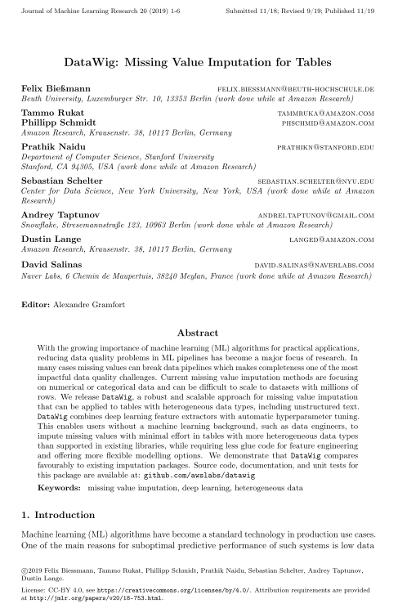
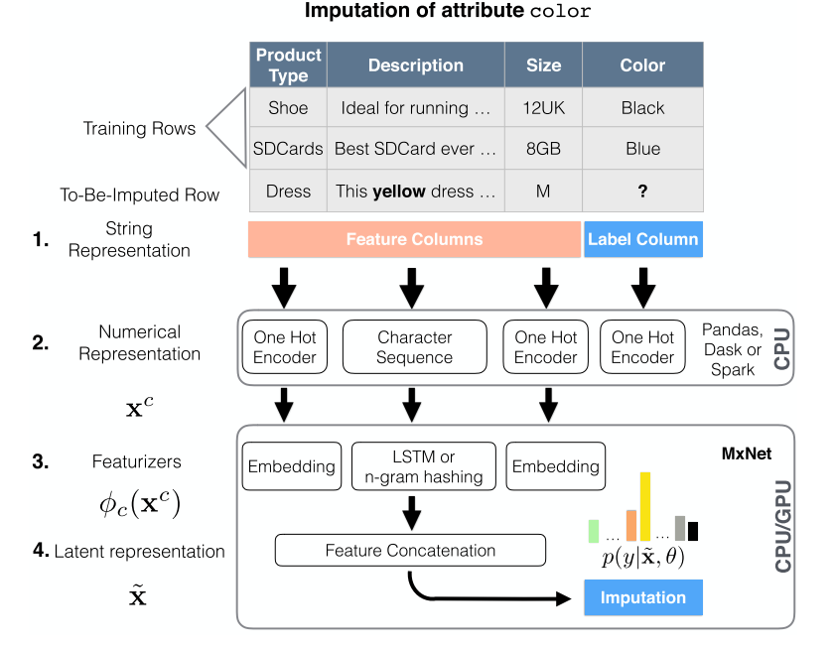
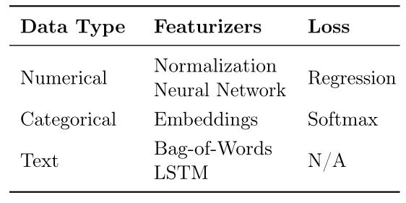
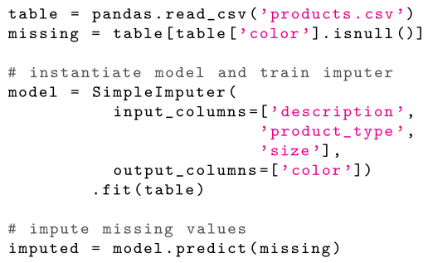
DNN Based MV Imputation
Missing Value Imputation
[Felix Bießmann et al: DataWig: Missing Value Imputation for Tables, J. of ML Research 2019]
DataWig
Missing values imputation for heterogeneous data including unstructured text

Slide 35
Query Planning w/ MV Imputation
Missing Value Imputation
Dynamic Imputation
Data exploration w/ on-the-fly imputation
Optimal placement of drop δ and impute μ (chained-equation imputation via decision trees)
Multi-objective optimization
[Jose Cambronero, John K. Feser, Micah Smith, Samuel Madden:
Query Optimization for Dynamic Imputation. PVLDB 2017]
Quality Optimized
Plan
Perf Optimized
Plan

Slide 36
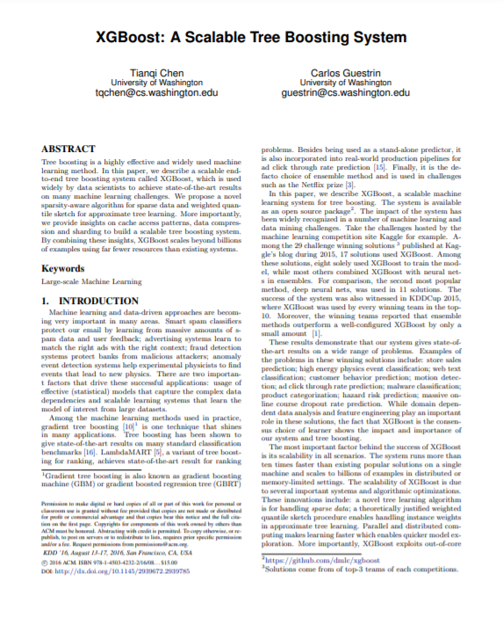
XGBoost’s Sparsity-aware Split Finding
Missing Value Imputation
Motivation
Missing values
Sparsity in general (zero values, one-hot encoding)
XGBoost
Implementation of gradient boosted decision trees
Multi-threaded, cache-conscious
Sparsity-aware Split Finding
Handles the missing values by default paths (learned from data)
An example will be classified into the default direction when the feature needed for the split is missing
[Tianqi Chen and Charlos Guestrin: XGBoost: A Scalable Tree Boosting System, KDD 2016]
Example | Age | Gender
X1 | ? | male
X2 | 15 | ?
X3 | 25 | female
age < 20
Y
N
default
Is male?
X3
Y
N
X1
default
X2

Slide 37
Time Series Imputation
Missing Value Imputation
[Steffen Moritz and Thomas Bartz-Beielstein: imputeTS: Time Series Missing Value Imputation in R, The R Journal 2017]
Example R Package imputeTS

Slide 38
Summary and Q&A
Motivation and Terminology
Data Cleaning and Fusion
Missing Value Imputation
Next Lectures (Part B) by Dr. Lucas Iacono
08 Cloud Computing Foundations [Nov 29]

